Slide 1
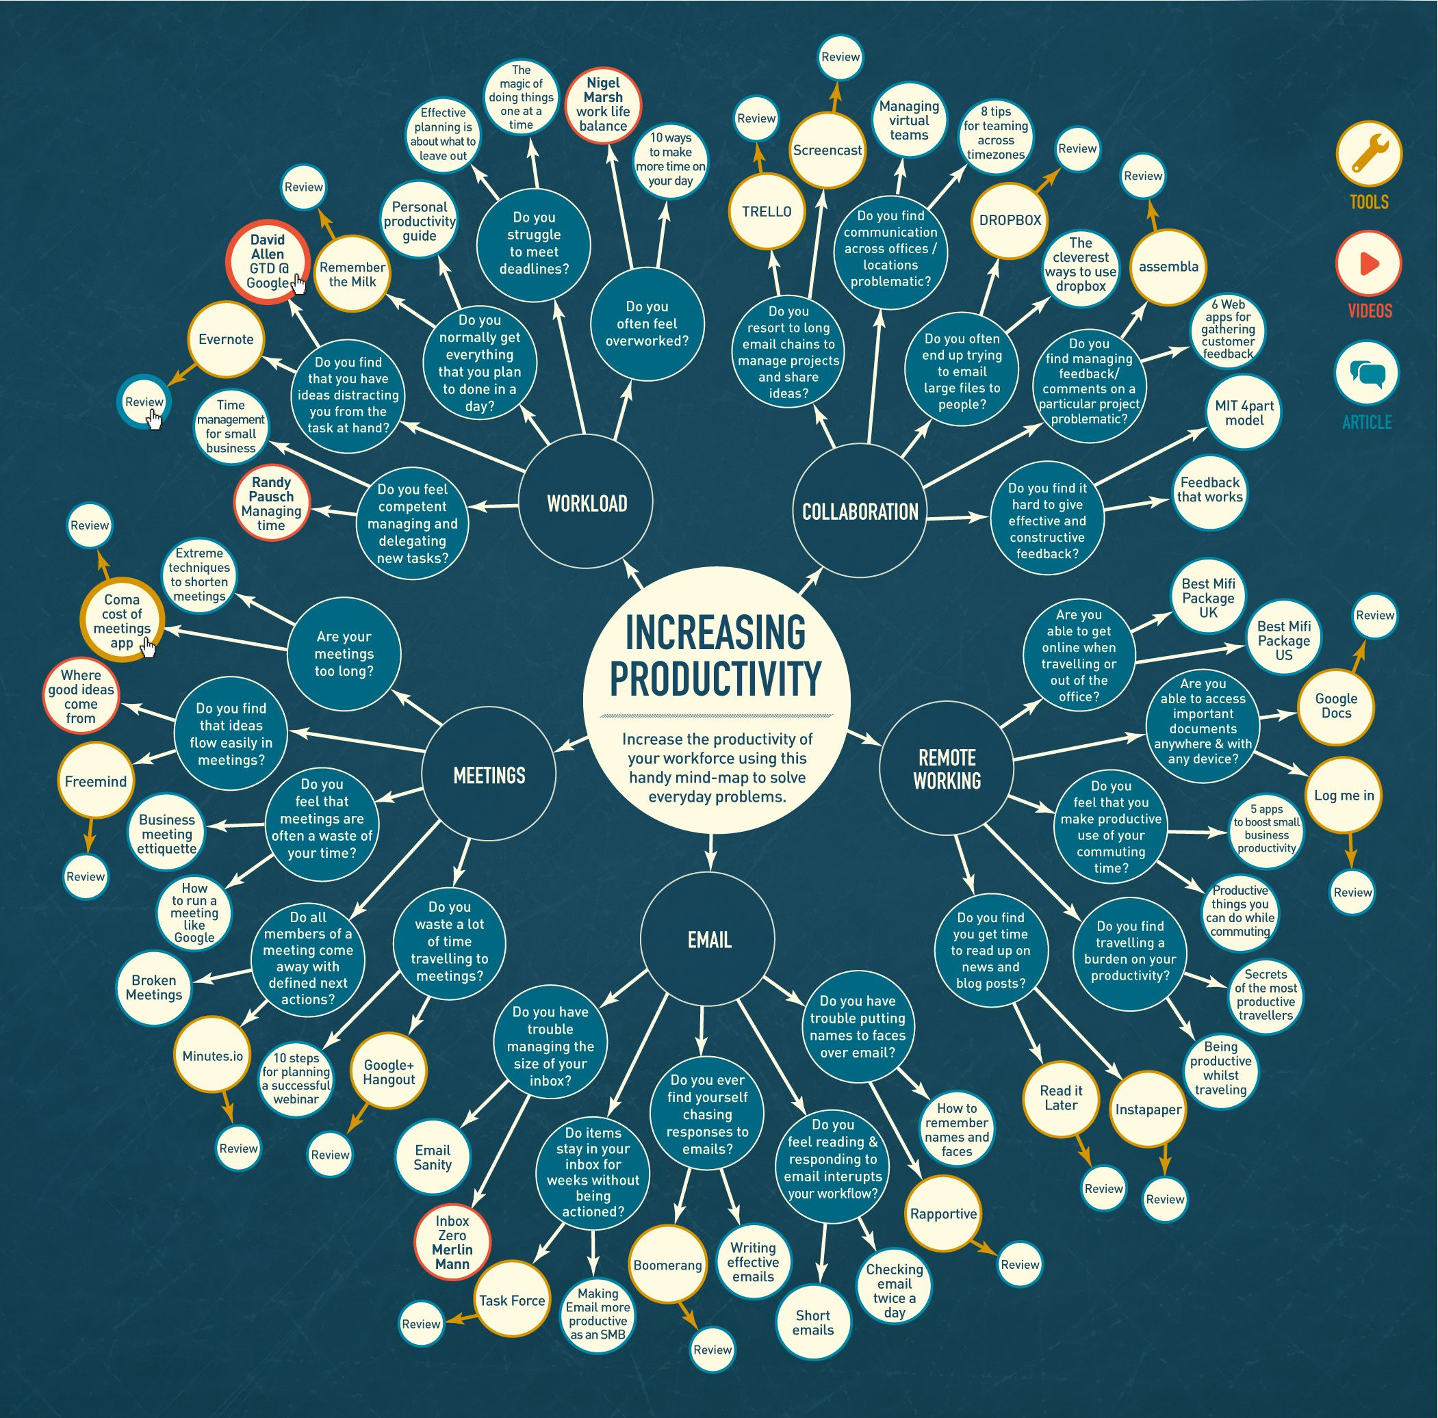
Mindmap in Javascript
Students
Supervisor
Correlator
Client
De Boni Jonathan
Zorloni Gabriele
Galli Vanni
-
Galli Vanni
Degree Course
N° Project
Year
Date
Computer Engineering
C10007
2018/2019
03/05/2019
Abstract
A Mindmap, is a diagram used to visually organize information. It is organized in a hierarchical manner and with the use of connectors the relationships between the individual components of it are displayed. Normally a mind map is generated starting from a central concept (first level, which is visually placed at the center of the diagram) and from this branch out lines that touch second level information. Second-level information then goes to branch lines that connect one or more third-level information and then follow fourth-level information and so on. Information is often keywords, concepts, images or sketches.
Targets
The first part of the project consists of an analysis of the functioning of Mindmaps and their use. In the second part it is required to analyze the tools on the market that allow you to create and manage a Mindmap. The final aim of this semester work is to develop a tool for creating and manipulating a Mindmap using Javascript technology (usable via web).
Conclusion
The real difficulty of this project was to make our application better and more functional in the development of projects that would allow the construction of Mindmap, as many software allow the construction of graphs but are not specific for Mindmaps.
The use of our software allows you to customize your project making it unique and fast to develop, to save it for a future modification and possibly to integrate with similar applications.

